Slide 1

Citizen AI - Intelligent Citizen Engagement Platform
Aljuvaireya P
BCA Student
Valliammal College for Women

Slide 2

What is Citizen AI ?
Citizen AI is an innovative platform designed to improve communication and collaboration between citizens and government.
It leverages Artificial Intelligence to provide smart solutions for public queries, grievances, and engagement.
The platform ensures transparency, efficiency, and accessibility in civic services.
It empowers citizens with real-time information and faster resolution of issues.

Slide 3

Citizen AI
Purpose | Scope
To give citizens a simple way to ask questions anytime. To provide instant, human-like replies using AI. To make services available 24/7. To understand how citizens feel about services. To give officials a clear view of citizen feedback in one place. To improve services based on real feedback. | It is used for answering citizen questions quickly. It helps in reporting issues or requesting information. It can be expanded to handle more government services in future and social media or digital inputs. It helps officials track overall public satisfaction. It can be upgraded to show more detailed government data.

Slide 4





Implementation
Programming Language
Backend
Libraries
Platform
Functions
Python
IBM Granite AI Model
( granite-3.2-2b-instruct )
Transformers
Torch [ pyTorch ]
Gradio
Google Colab with GPU Support
City Analysis
Citizen Interaction

Slide 5
Technical Overview
Backend | IBM Granite AI Model ( granite-3.2-2b-instruct ) | A pre-trained large language model that understands and responds to natural language queries. Handles citizen questions with contextual, human-like answers.
Libraries | Transformers | Provides tools to load and use pre-trained AI models easily.
 | Torch ( PyTorch ) | Framework for running deep learning models efficiently on GPUs.
 | Gradio | Creates an interactive interface for citizens to input queries and view AI responses.

Slide 6

Technical Overview
Platform | Google Colab with GPU support | Enables high-performance computation without local setup. Allows running large AI models smoothly.
Functions | City Analysis | Generates city safety and crime reports.
 | Citizen Interaction | Generates responses to citizen queries.

Slide 7

System Flow
User enters input in the Gradio web interface
City Name → for safety and crime analysis
Query → for government services or civic issues
Input is sent to the Python backend function
( city_analysis or citizen_interaction )
.
Backend prepares a prompt for the IBM Granite AI model
The AI model generates the response
Response is decoded and cleaned
Output is displayed back to the user on the interface

Slide 8

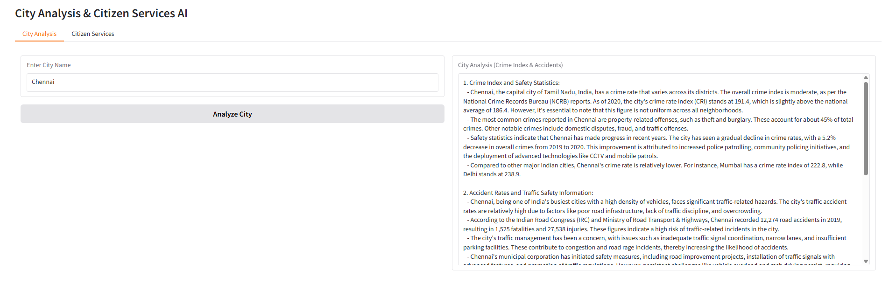
Output

Slide 9

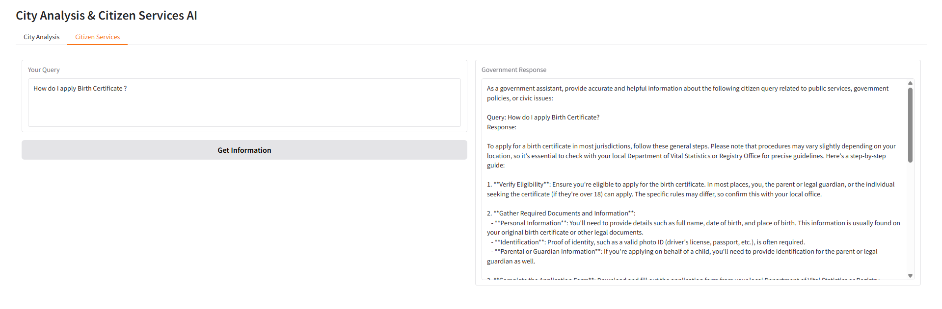
Output

Slide 10

Conclusion
Helps citizens get answers to their questions quickly and easily.
Makes public services simple and easy to use.
Can grow and add more services in the future.
Supports transparent and citizen-friendly governance.
Reduces the need for citizens to wait or visit offices.
Provides accurate and reliable information anytime.
Makes government services more accessible to everyone.
Encourages better communication between citizens and authorities.

Slide 11

Thank you for your valuable time

